Slide 1
2014 Crime Stats for Rochester, NY
February 19, 2015
Chief Michael Ciminelli

Slide 2
2014 Part I Crime

Slide 3
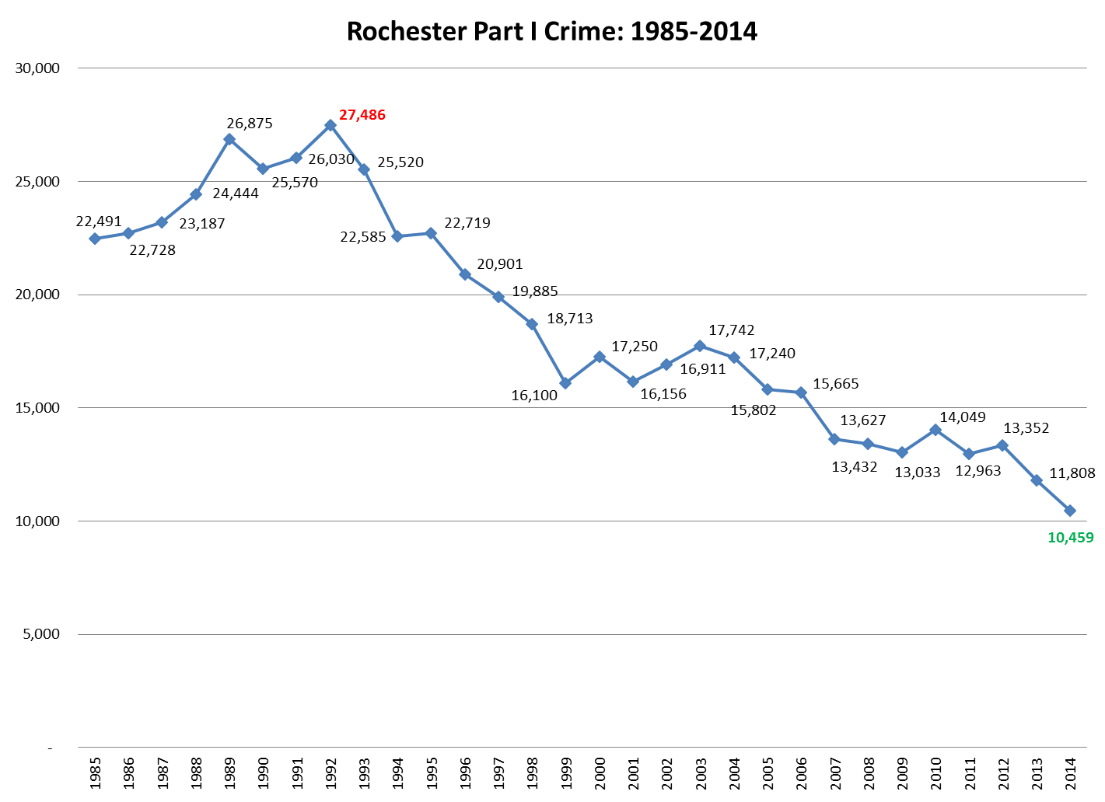

Slide 5
Key Part I Crime Successes in 2014
Lowest Part I Crime level in 25 years
Fewer than 11,000 Part I crimes for the 1st time in 25 years
1985-2012: ZERO years with less than 12,000
Lowest Violent Crime levels in 10 years; 2nd lowest in 25 years
Robbery and Aggravated Assault each at 25-year lows
Robbery down 20.9% from 2013
Aggravated Assault down 17.1% from 2013
78.1% Homicide Clearance Rate
25 of 32* cases closed with an arrest in 2014
Lowest Property Crime levels in 25 years
Burglary and Larceny each at 25-year lows
Fourth consecutive year of Burglary decline after a 15-yr high in 2010

Slide 6
Key Challenges in 2014
Increase in Rapes
Up 27.9% from 2013 and 12.5% from 5-year avg.
Decrease in Gun Recoveries
Down 35% from 2013 and 24.5% from 5-year avg.
Increase in Motor Vehicle Theft
Up 11.2% from 2013
First year-to-year increase in since 2006

Slide 9
Homicide
Clearances: 78.1% (25 out of 32* ) of homicides closed with arrest by calendar year end
Weapon Type:
81% involving a firearm, up from 69% in 2013 (typically 75-85%)
3 murders (9.4%) involved a knife/cutting instrument
1 murder resulted from a physical beating
Non-Random: Victim knew the suspect in 19 instances
Circumstances:
Known gang involvement in at least 17 cases (53.1%)
At least 59.4% (19/32) cases involved a dispute of some kind
7 occurred during the immediate aftermath of a physical altercation
* Two homicides from previous years, 1994 and 1999 respectively, are counted in the yearly totals but excluded from the 2014 analysis .

Slide 11
Rape
Up 27.9% from 2013 and 12.5% from the 5-yr avg.
Double-digit increase (year to year) for Q2,Q3,Q4
Increase from 2013 primarily in NE (59.3%) and NW (30.4%) quadrants
No abnormal monthly, weekly, or hourly patterns
Weapon Type:
91.8% involved no weapon (physical only)
3.6% involved a firearm
3.6% involved a knife
Non-Random Violence:
72.1% of cases involved a suspect known to the victim
Cases involving a stranger down 6.7% from 2013 and 25.7% from 5-yr average
71.9% of cases occurred indoors
81.1% in 2013
5-yr. average is 79.8%

Slide 12
Robbery
Lowest Citywide robbery total in 25 years
Down 20.9% from 2013 and 14.3% from the 5-yr avg.
All quadrants observed double-digit decreases
Double-digit decrease (year to year) for Q1,Q2,Q4
Weapon Type:
45.6% involved a firearm
28.7% involved no weapon
10.0% involved a knife
91.4% of cases involved a suspect unknown to the victim
75.4% of cases occurred outdoors
Consistent level over past 5 years

Slide 13
Aggravated Assault
Lowest Citywide Agg. Aslt. total in 25 years
Down 17.1% from 2013 and 29.6% from the 5-yr avg.
55.6% of all aggravated assaults involve a threat of violence with a weapon (Menacing 2nd)
Indicative of interpersonal disputes
No actual injury occurs
Consistent level over past 5 years
Weapon type in physical assaults:
37.6% involved a knife
31.8% involved a firearm
9.6% involved no weapon
Non-Random Violence: 56.7% of aggravated assaults involve a victim and suspect who know each other (acquaintance or intra-family)
8.6% of all aggravated assaults occur within the family
17.5% of all aggravated assaults involve an intimate partner
Relationship is unknown or not given in 19.8% of cases
Note: Due to a reporting change, data prior to 2005 is not comparable to current totals-previous totals did not count menacing.

Slide 14
Burglary
Lowest Citywide Burglary total in 25 years
Down 14.7% from 2013 and 29.7% from 5-yr avg.
29.2% year to year reduction in 1st half (Q1-Q2) leveled in 2nd half (Q3-Q4)
Significant reductions in 3 of 4 quadrants:
Northeast: -19.1%
Southeast: +3.6%
Northwest: -20.8%
Southwest: -21.0%
Residential burglaries account for 83.6% of all burglaries citywide
40.8% have no forced entry
21.8% involve unlocked doors or windows
12.4% occur at vacant houses
75.4% of metal thefts occur vacant houses

Slide 15
Larceny
Lowest Citywide Larceny total in 25 years
Down 10.4% from 2013 and 15.5% from 5-yr avg.
Reductions in all four quadrants
Car break-ins accounted for 60.2% of all outdoor larcenies (24.5% of all)
54.8% occur in a parking lot
42.4% occur on the street

Slide 16
Motor Vehicle Theft
1st year to year increase since 2005
Still 2nd lowest total in 25 years
Up 11.2% from 2013 and down 9.9% from 5-yr avg.
Spiked in Q3 (Jul-Sep): up 65.5% from 2013
Geographically dispersed by quadrant
Most common theft locations:
Street – 39.9%
Residential Location – 26.2%
Parking Lot – 26.2%
Commercial Location – 7.3%
Key remaining issues:
Unattended running vehicles
Older models lacking anti-theft features

